Slide 1
Psychophysical scaling
reveals a unified theory of
visual memory strength
Schurgin, Wixted, Brady (2020)
https://doi.org/10.1038/s41562-020-00938-0
Presented by Danny Garside on 20221130 at the LSR journal club
Notes:
This paper is all about modelling performance on a working memory task
A rather pleasing theory-driven model for working memory

Slide 2
Cue

Slide 3

Choice

Slide 4
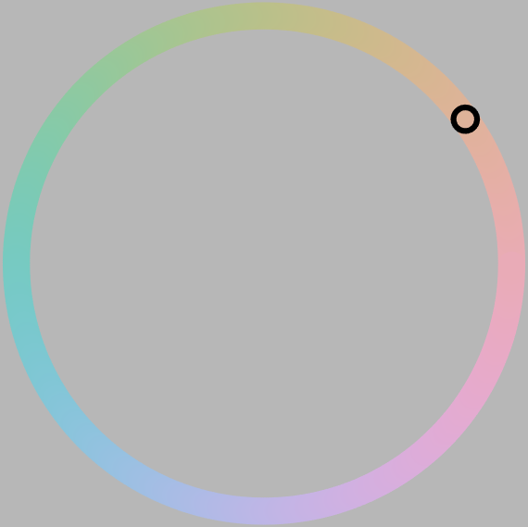
Choice

Slide 5
Modelling - a “mixture model”
Notes:
When you collect a lot of data for a task like this, and average it all together, you get something that looks like this:

Slide 6
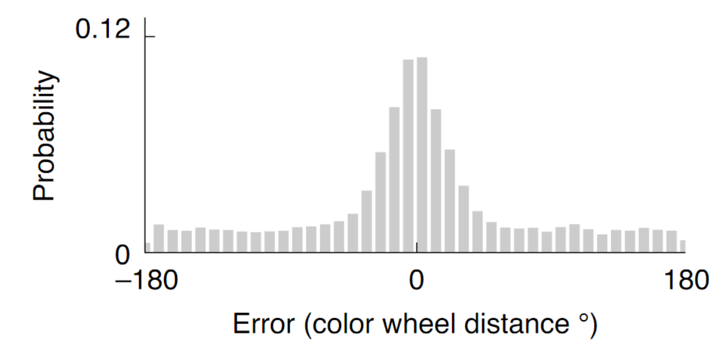
Modelling - a “mixture model”
F1B
Notes:
When you collect a lot of data for a task like this, and average it all together, you get a response distribution that looks something like this:
A large number of small errors and a small number of large errors

Slide 7
Modelling - a “mixture model”
F1B
Notes:
Mixture model - it is a mixture of:
A nice smooth normal distribution…

Slide 8
Modelling - a “mixture model”
F1B
Notes:
On top of a uniform distribution

Slide 9
Modelling - a “mixture model”
Noise acting on a point
Guesses
F1B
Notes:
The way that this has been thought of has been as two different sources of error - noise acting on the representation, that has a gaussian-like profile, with the uniform floor provided by guesses.

Slide 10
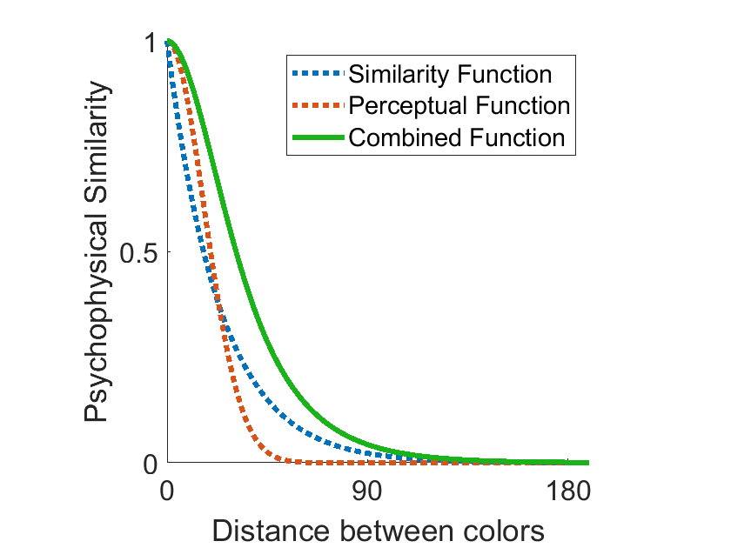
Modelling - TCC model
Based on F1F

Slide 11
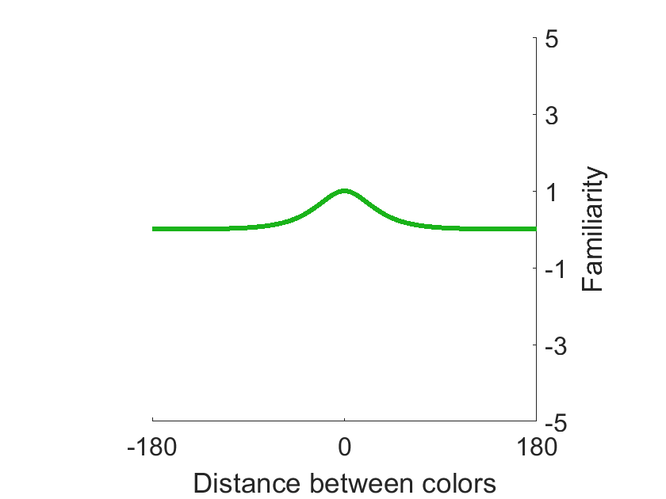
Modelling - TCC model
Based on F1F
Based on F2B
Notes:
Each color is going to be acted on by noise
And the highest noisy bin is going to be counted as the most familiar, and reported as the choice
Similarity is stable, familiarity is trial-by-trial
Here I’ve normalised it to 0, but imagine that on different trials it is different colors

Slide 12
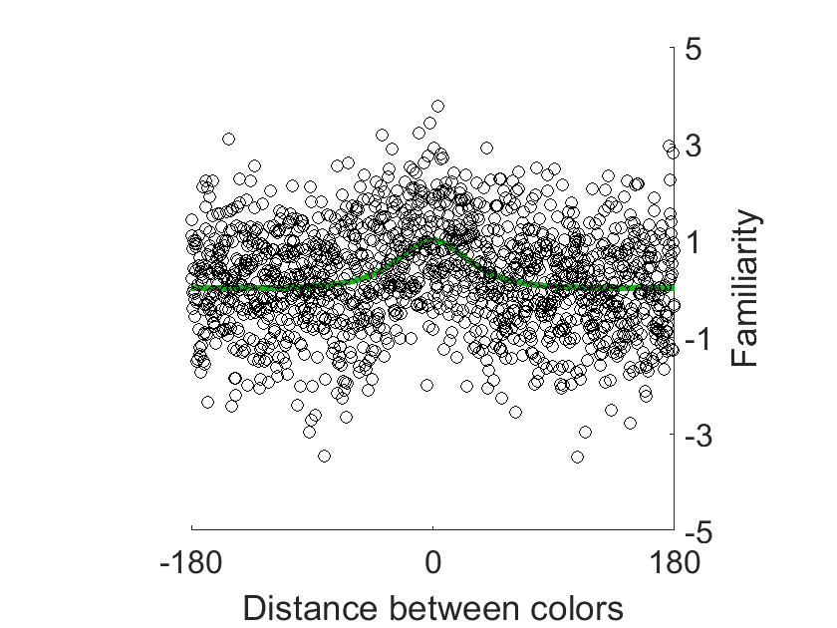
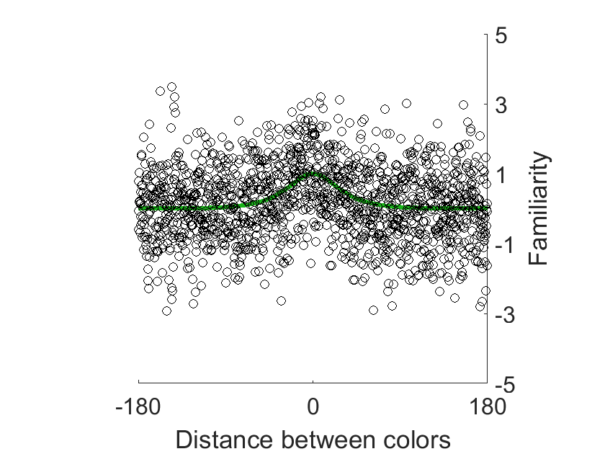
Modelling - TCC model
Based on F1F
Based on F2B

Slide 13
Modelling - TCC model
Based on F1F
Based on F2B

Slide 14
Modelling - TCC model
Based on F1F
Based on F2B

Slide 15
Modelling - TCC model
d’ = 1
Based on F1F
Based on F2B

Slide 16
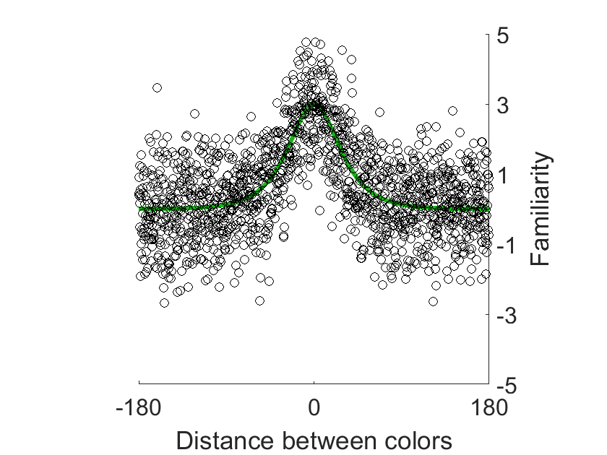
Modelling - TCC model
d’ = 3
Based on F1F
Based on F2B

Slide 17
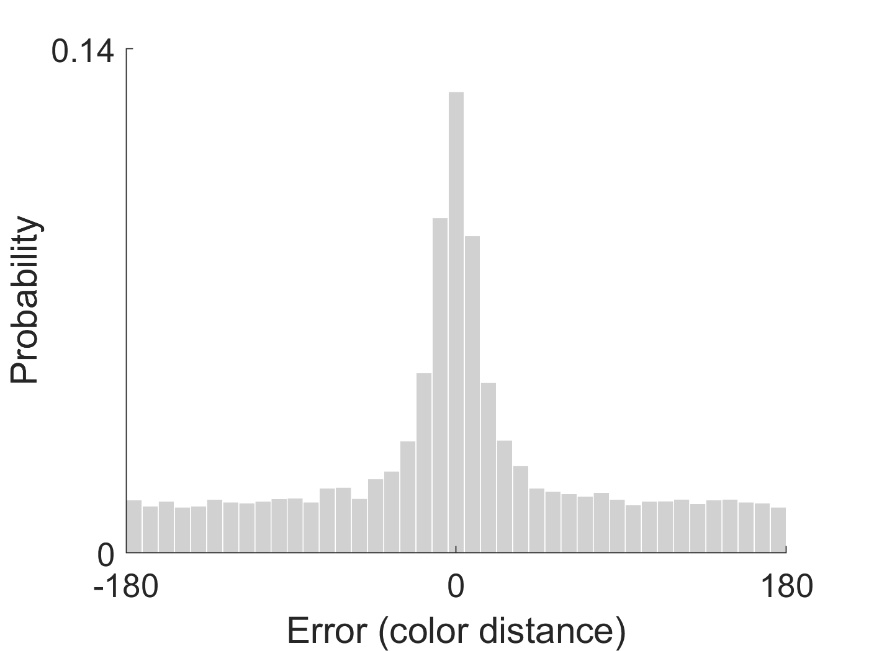
Modelling - TCC model
d’ = 1
Based on F1F
Based on F1B
Notes:
Different d-prime values
Same similarity function, just different levels of noise

Slide 18
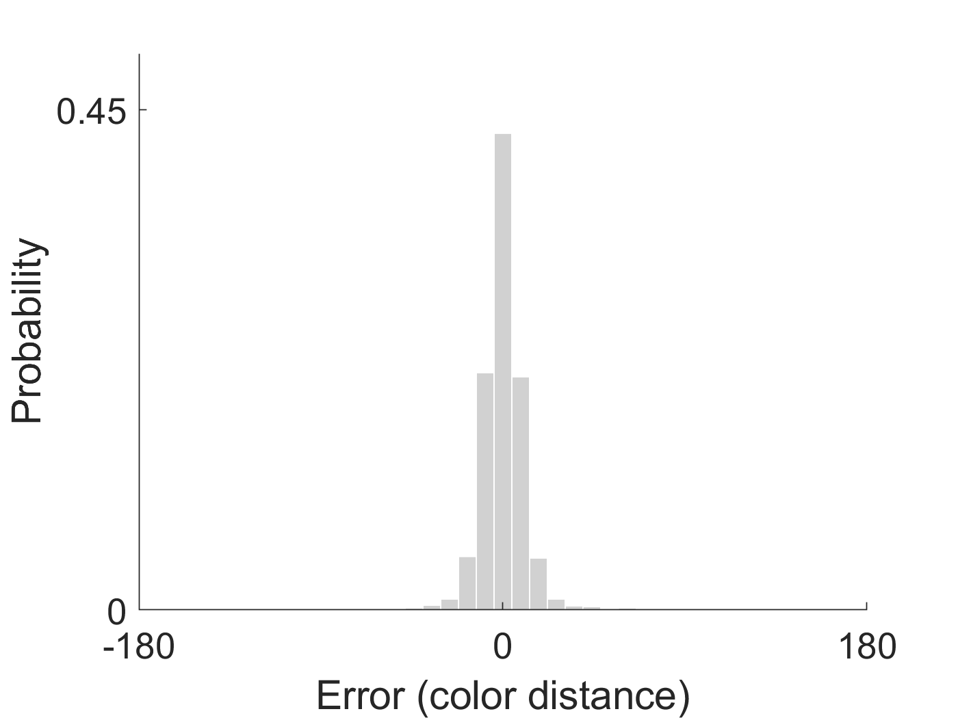
Modelling - TCC model
d’ = 3
Based on F1F
Based on F1B
Notes:
Different d-prime values
Same similarity function, just different levels of noise

Slide 19
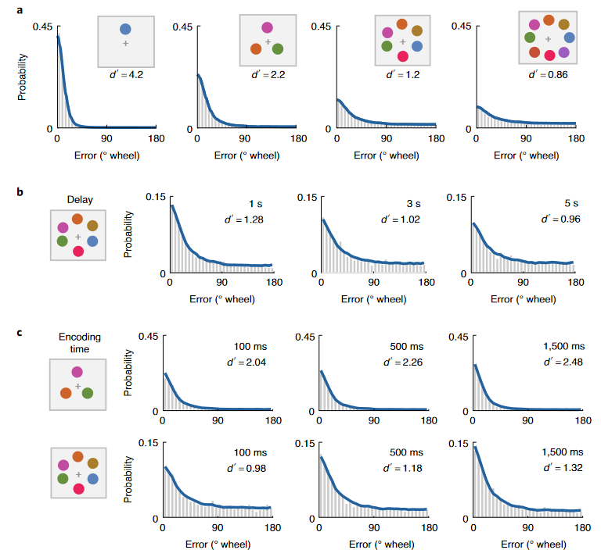
F3
Notes:
This predicts multiple different loadings/expected noise levels

Slide 20
F3
Notes:
This predicts multiple different loadings/expected noise levels

Slide 21
F3
Notes:
This predicts multiple different loadings/expected noise levels

Slide 22
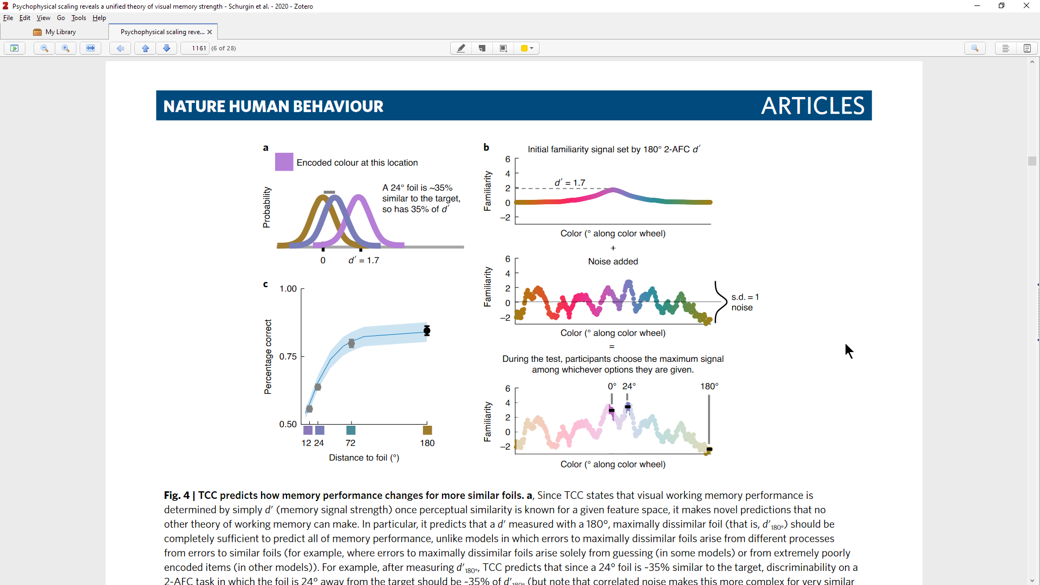
Predicting performance across the space just from d’
F4C
Notes:
Even when you can only sample 2 points in the space, which the previous model wouldn’t be able to do
(It works for other spaces too)

Slide 23
Predicting performance just from d’
Prediction
New Data
F4C
Notes:
Even when you can only sample 2 points in the space, which the previous model wouldn’t be able to do
It works for other spaces too - they test faces

Slide 24
Biases in working memory responses
Error-correcting dynamics
in visual working memory
Panichello, DePasquale, Pillow, Buschman
(2019)
https://doi.org/10.1038/s41467-019-11298-3
Why some colors appear
more memorable than others:
A model combining
categories and particulars
in color working memory.
Bae, Olkkonen, Allred, Flombaum (2015)
https://doi.org/10.1037/xge0000076
Notes:
Now that’s all cool and stuff, but I want to use it to answer a question that I’ve been trying to work out an answer for for a while - where do biases in memory recall tasks (esp color recall tasks) come from? Both why and how?

Slide 25
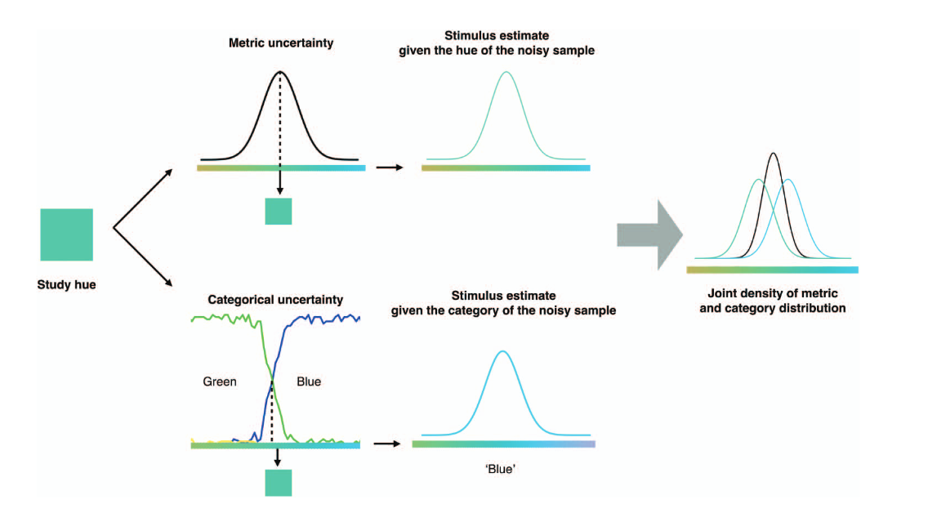
Biases in working memory responses
Why some colors appear
more memorable than others:
A model combining
categories and particulars
in color working memory.
Bae, Olkkonen, Allred, Flombaum (2015)
https://doi.org/10.1037/xge0000076
Notes:
Previously: folks have thought that they arise from categorical encoding…

Slide 26
Biases in working memory responses
Why some colors appear
more memorable than others:
A model combining
categories and particulars
in color working memory.
Bae, Olkkonen, Allred, Flombaum (2015)
https://doi.org/10.1037/xge0000076
Notes:
Previously: folks have thought that they arise from categorical encoding…

Slide 27
Biases in working memory responses
Error-correcting dynamics
in visual working memory
Panichello, DePasquale, Pillow, Buschman
(2019)
https://doi.org/10.1038/s41467-019-11298-3
Notes:
or attractor points in a space

Slide 28
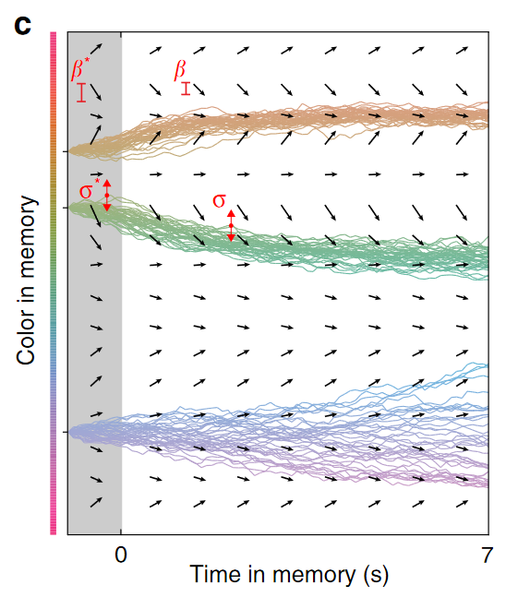
Biases in working memory responses
Error-correcting dynamics
in visual working memory
Panichello, DePasquale, Pillow, Buschman
(2019)
https://doi.org/10.1038/s41467-019-11298-3
Notes:
or attractor points in a space

Slide 29
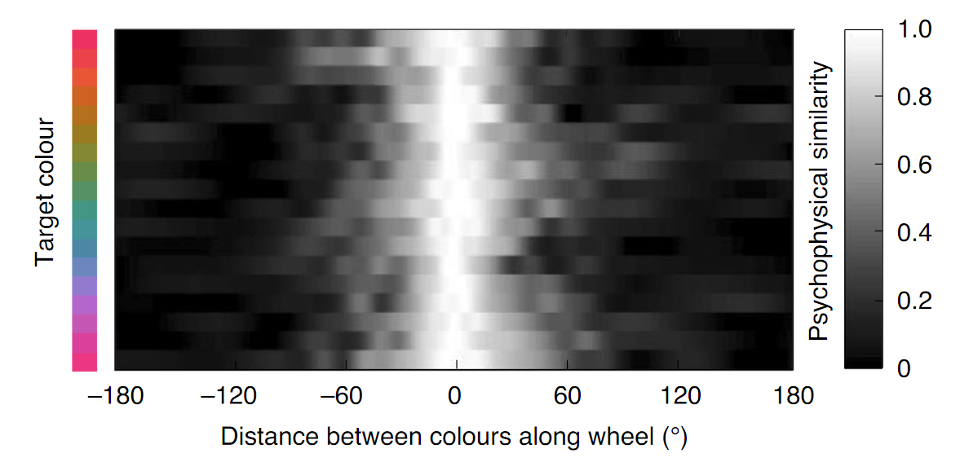
Schurgin, Wixted, Brady (2020)
F1D
Notes:
In this whole paper they have assumed that there is a single similarity function.
I.e. that colorspace is homogenous - that a distance in one direction, will be the same as a distance in another direction.
This would be lovely, but it’s been a pipe dream of the color community for over a hundred years.

Slide 30
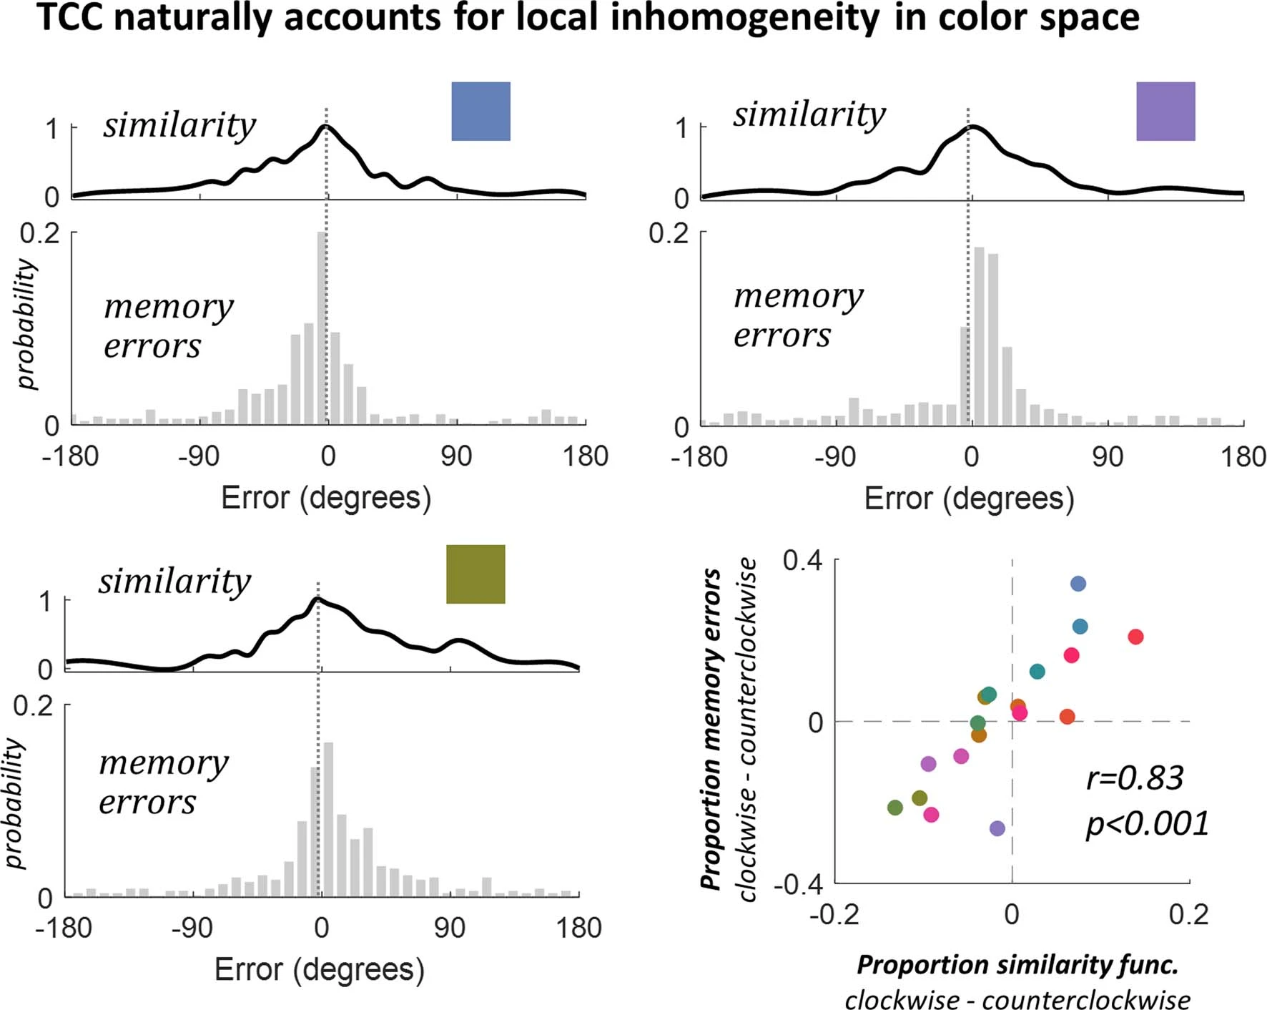
Schurgin, Wixted, Brady (2020)
F1D
EDF5
Notes:
In this whole paper they have assumed that there is a single similarity function.
I.e. that colorspace is homogenous - that a distance in one direction, will be the same as a distance in another direction.
This would be lovely, but it’s been a pipe dream of the color community for over a hundred years.

Slide 31
Schurgin, Wixted, Brady (2020)
F1D
EDF5
Notes:
In this whole paper they have assumed that there is a single similarity function.
I.e. that colorspace is homogenous - that a distance in one direction, will be the same as a distance in another direction.
This would be lovely, but it’s been a pipe dream of the color community for over a hundred years.

Slide 32
Schurgin, Wixted, Brady (2020)
F1D
EDF5
Notes:
In this whole paper they have assumed that there is a single similarity function.
I.e. that colorspace is homogenous - that a distance in one direction, will be the same as a distance in another direction.
This would be lovely, but it’s been a pipe dream of the color community for over a hundred years.
Across all the colors you see this relationship.
Remember that the similarity and the memory errors were collected on different tasks, and so showing the relationship between them shows that it’s not just that there’s noise in the measurement of one of the other.

Slide 33
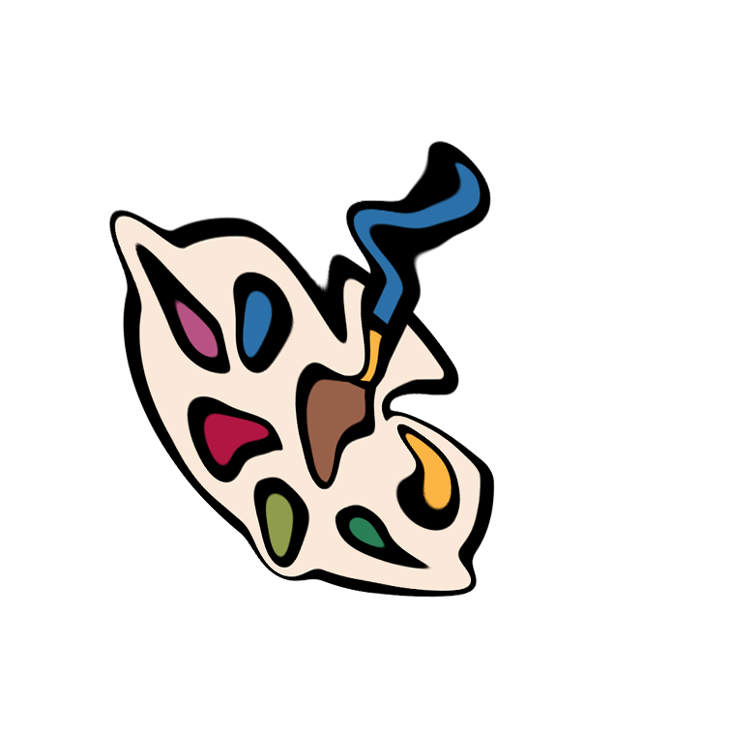



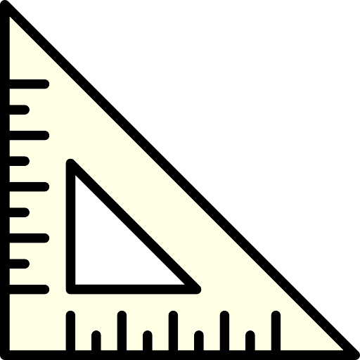

Multiple different similarity functions (in current space)?
Or a single similarity function in a modified space?
https://www.flaticon.com/free-icon/color-palette_2868103#
https://www.flaticon.com/free-icon/triangular-ruler_2775432
Notes:
I think they’re thinking about this upside down though.
What can be thought of as many similarity functions in one color space, can alternatively be thought of as one similarity function in a distorted space
I’m currently testing what I think is a simpler idea - that they arise from non-uniformity in spaces.
To explain this, let’s imagine that we knowingly picked color for our cues and our choices to be biased

Slide 34
Modelling data collected in our lab
Notes:
On the left is a model with thousands of free parameters - the relationship between every cue and every choice is floating
On the right, we have a single similarity function, BUT the location of the represented point in colorspace is allowed to float - moving closer or further away from other points.

Slide 35
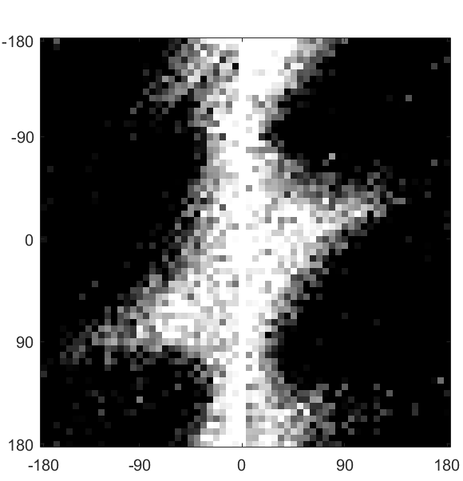
Modelling data collected in our lab
Notes:
We fit the similarity matrices on the data from the working memory task itself, which is cool

Slide 36
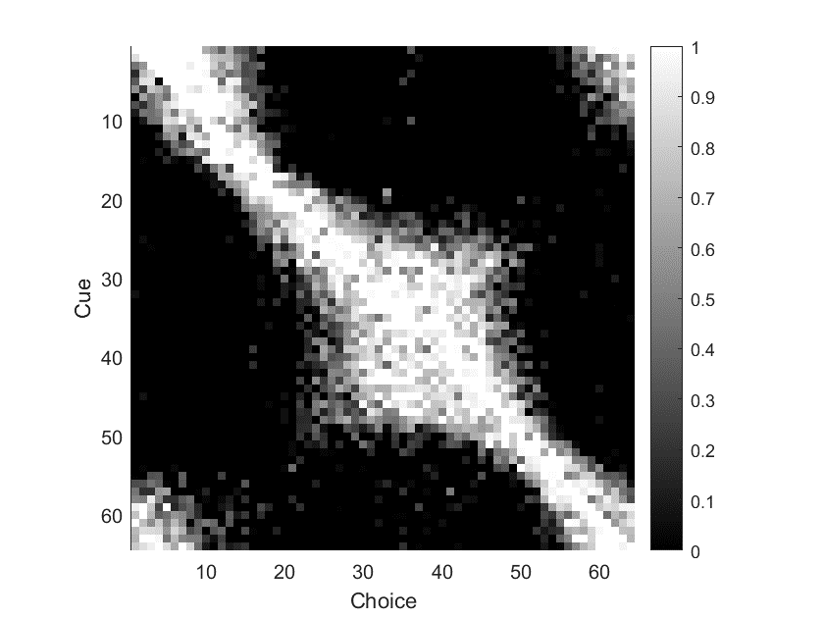
Modelling data collected in our lab
Notes:
I think it’s more useful to look at the data in a slightly different format, because it makes certain elements pop out.
So here instead I have the similarity matrix that is not normalised so that 0 error forms a vertical line.
Perfect performance would be an Identity matrix.
Spread around that identity matrix is expected - that is making small errors with choices that are perceptually close to the cue.
What I’m interested in is whether there is any spread that is symmetrical around that identity matrix, because that would suggest that points in that area are perceptually closer to their surrounding points than intended.

Slide 37
Modelling data collected in our lab
Notes:
I think it’s more useful to look at the data in a slightly different format, because it makes certain elements pop out.
So here instead I have the similarity matrix that is not normalised so that 0 error forms a vertical line.
Perfect performance would be an Identity matrix.
Spread around that identity matrix is expected - that is making small errors with choices that are perceptually close to the cue.
What I’m interested in is whether there is any spread that is symmetrical around that identity matrix, because that would suggest that points in that area are perceptually closer to their surrounding points than intended.

Slide 38
Modelling data collected in our lab
Notes:
How does this cause bias?
How much of this variability can we recover just moving the points around in colorspace.
This is akin to asking: assuming that our space is inhomogenous,
This is a model with thousands of free parameters - the relationship between every cue and every choice is floating

Slide 39
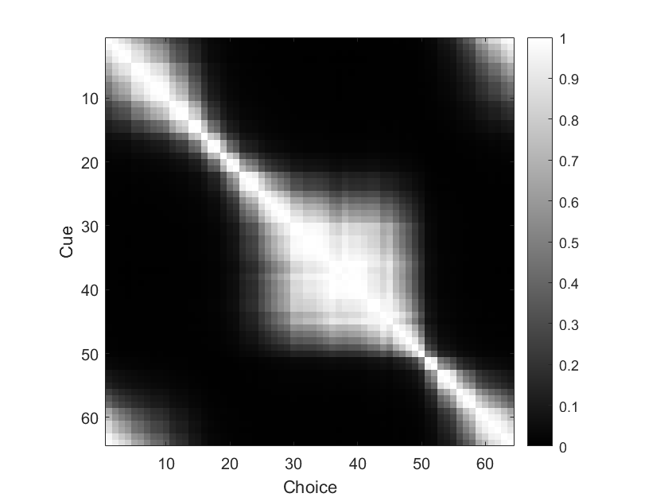
Modelling data collected in our lab
Notes:
On the right, we have a single similarity function, BUT the location of the represented point in colorspace is allowed to float - moving closer or further away from other points.

Slide 40
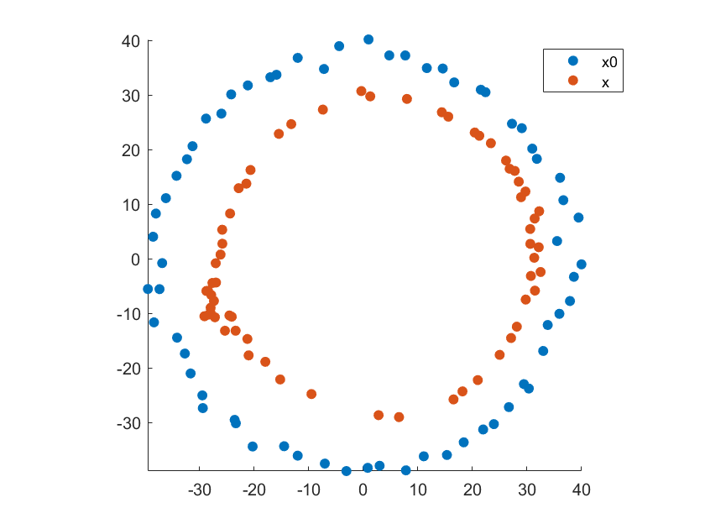
Modelling data collected in our lab
Notes:
On the left is a model with thousands of free parameters - the relationship between every cue and every choice is floating
On the right, we have a single similarity function, BUT the location of the represented point in colorspace is allowed to float - moving closer or further away from other points.

Slide 41
Modelling data collected in our lab
Notes:
On the left is a model with thousands of free parameters - the relationship between every cue and every choice is floating
On the right, we have a single similarity function, BUT the location of the represented point in colorspace is allowed to float - moving closer or further away from other points.

Slide 42
Conclusions
Nice model
Parsimonious
Biologically plausible (?)
Building on it for our work looking at bias
If anyone has good ideas/experience extracting confidence/likelihood intervals from models with many correlated parameters, help!?

